Slide 1
Of Whom We Hold Dear
Group 1
-Matthew Allum
-Aaron Mulligan
- Lee Hatchman
Notes:
Aaron: 4, 5, 6, 7, 11
Matt: 1, 2, 3, 10
Lee: 8, 9,

Slide 2
Audience/Logline
Take control and experience an ageing MC struggling with anterograde amnesia. Help him discover what he’s lost and find the truth behind his accident.
PC platform – First person perspective
Teens/Young males ~ females
Notes:
Audience/Logline
We will need to discuss who the character will be (example: Gender, age, anything about them unless we’re making it so the player is the character)
Sporadic productivity, will need to have a definition of what it means for the audience for them to have an understanding of what it means.
Could maybe turn the beginning of the logline into a rhetorical question, example: “Ever wonder what really happens to that one person who holds up a game lobby?”
Following it up with: “Come find out by playing as [character] who suffers from sporadic productivity who must complete menial tasks at the expense of others”

Slide 3
Gameplay
[Insert video of gameplay here]

Slide 4

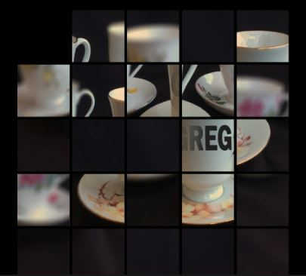
Progression
Sliding puzzle becomes harder (4x4 - 5x5 - 6x6)
Shorter blackout time limit
More rooms unlocked - more story

Slide 5
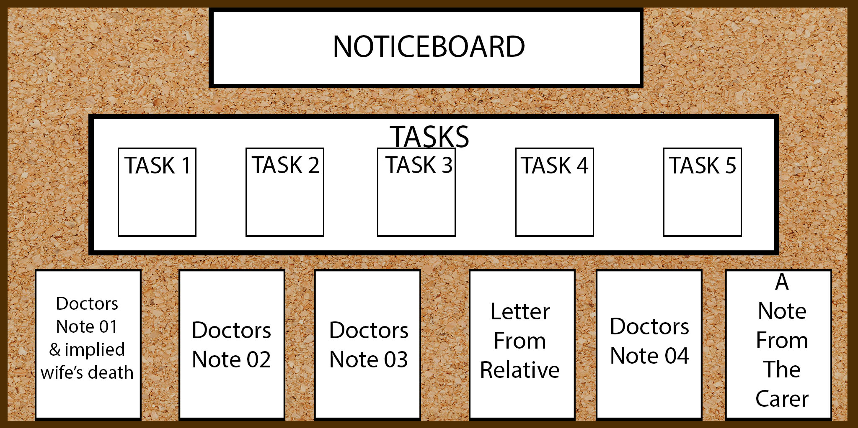
Noticeboard
Central hub for the player to go to
Displays objectives, lore and instructions
Updates as player progresses

Slide 6
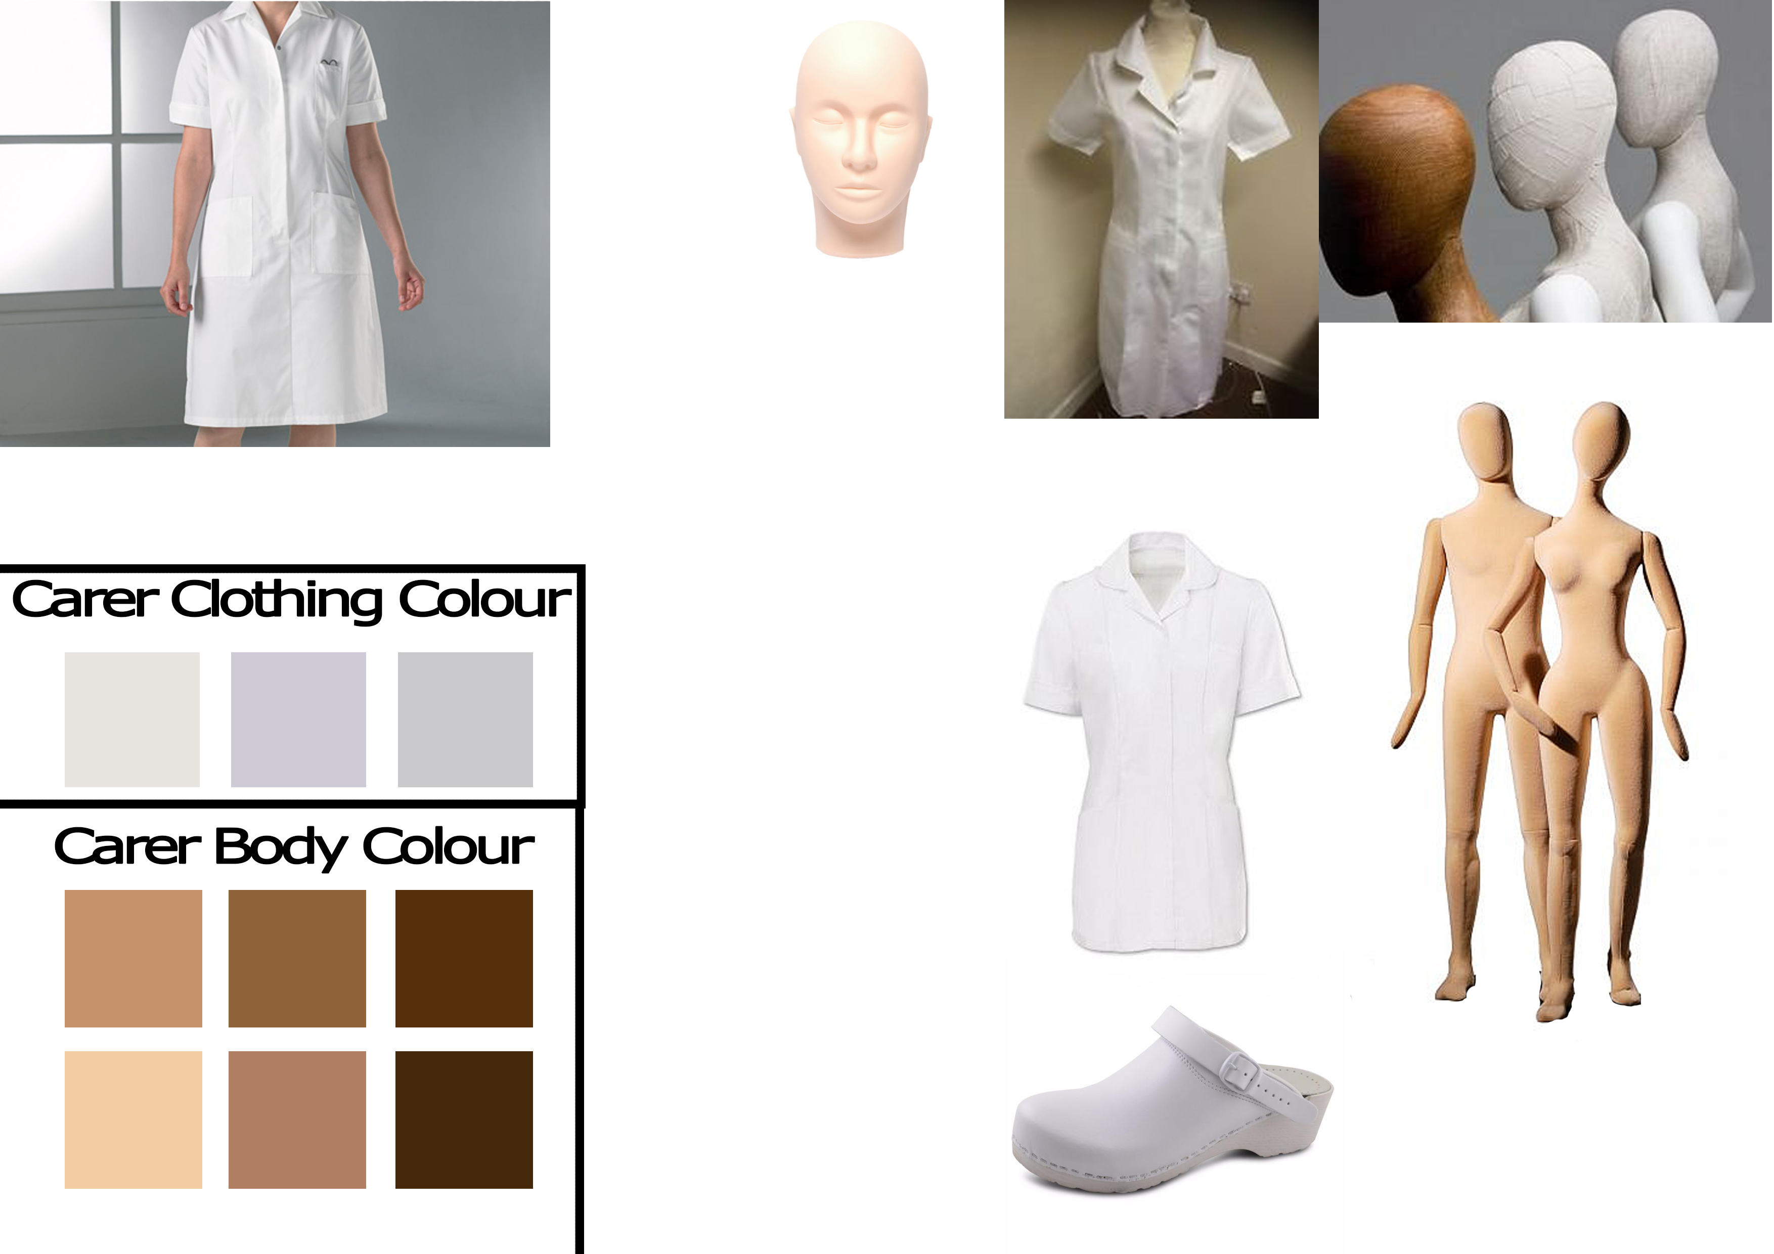
The Carer
Model of a mannequin
Moves on a systematic path around house
Only attempts to approach player if
In a puzzle
Fuse box goes out

Slide 7
Relationship between MC and The Carer
Carer
Fears the MC
Inadvertently acts as MC’s wife
Just trying to do her job
MC
Fears the Carer
Does not know who The Carer is
Feels The Carer is a threat to him

Slide 8
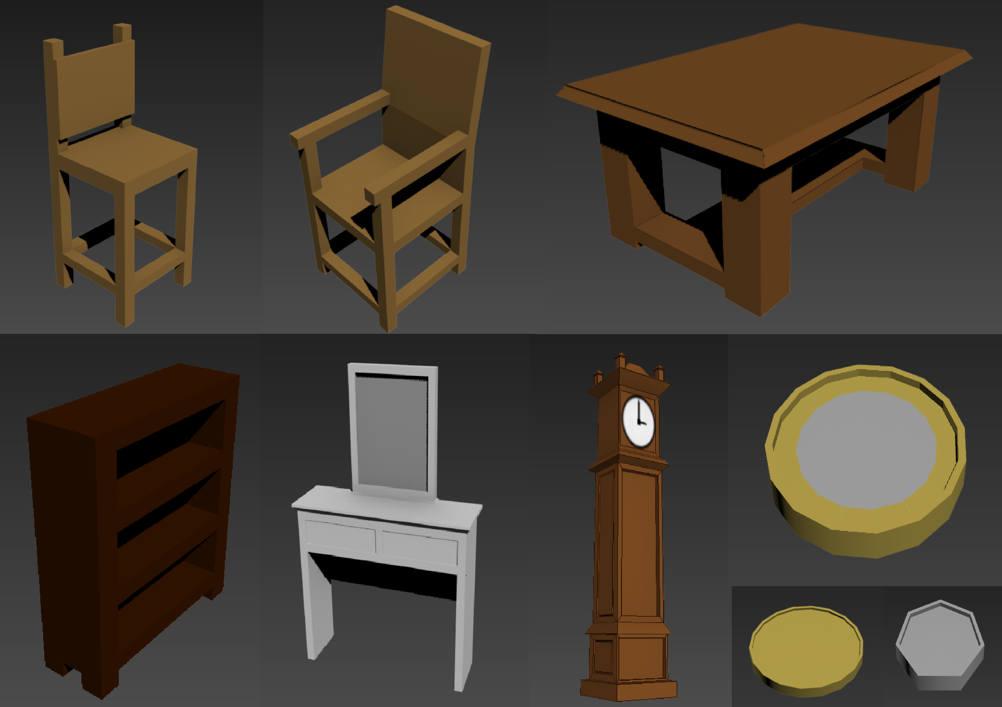
Furniture Designs

Slide 9
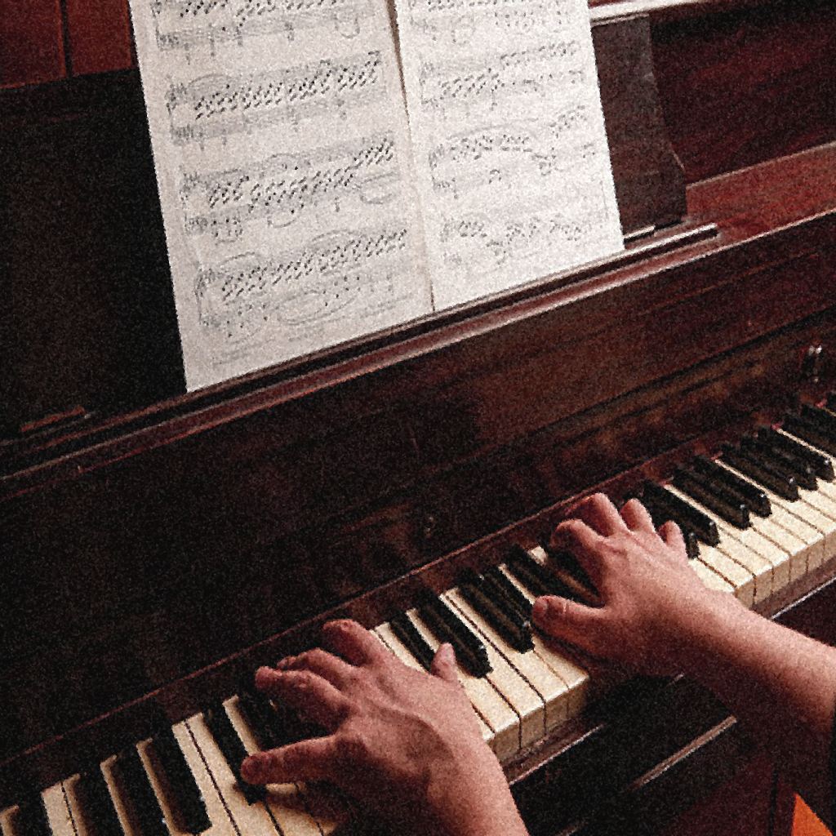
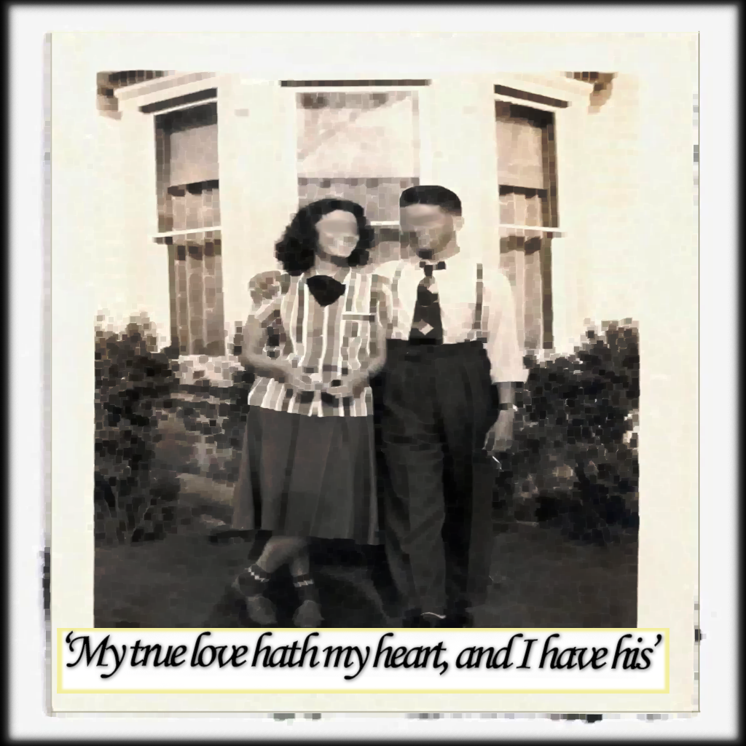

Puzzle Art

Slide 10
Total Sprint Hours

Slide 11

Future Tasks
Start getting the story in
Complete furniture models
Create and finish The Carer

Slide 12
Questions?

